Slide 1
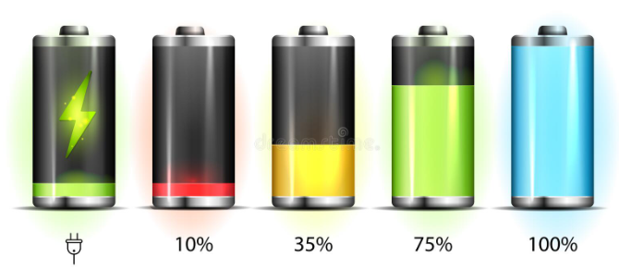
Energy level date
Out of the office
Name
Name
Name
Name
Name
Name
Name
Name
Name
Name
25%
50%
75%
100%

Slide 2
Energy level date
Out of the office
Name
Name
Name
Name
Name
25%
50%
75%
100%

Slide 3
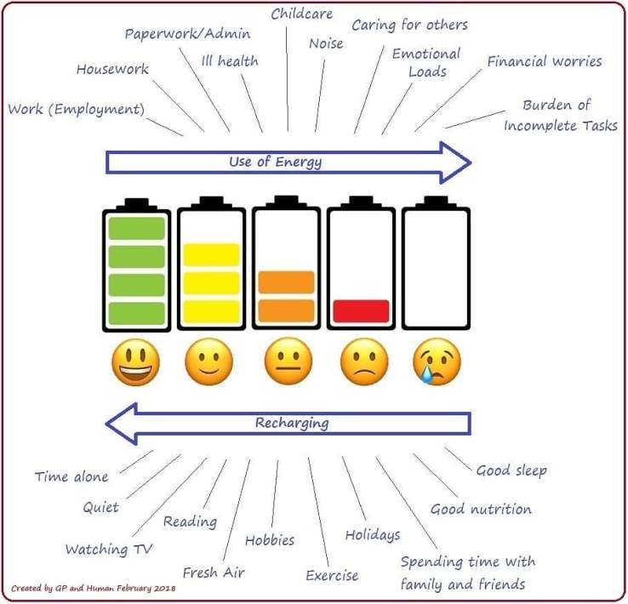
Chargers and Drainers
Name
Name
Name
Name
Name

